Slide 1


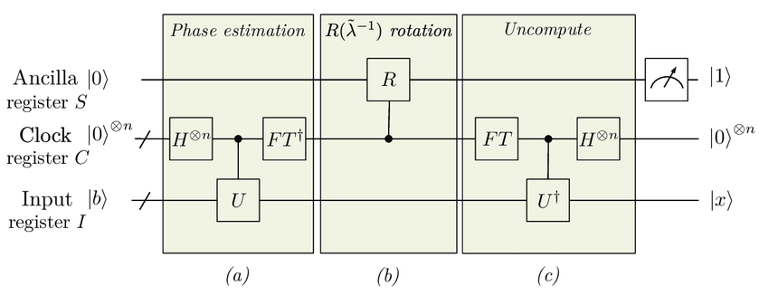
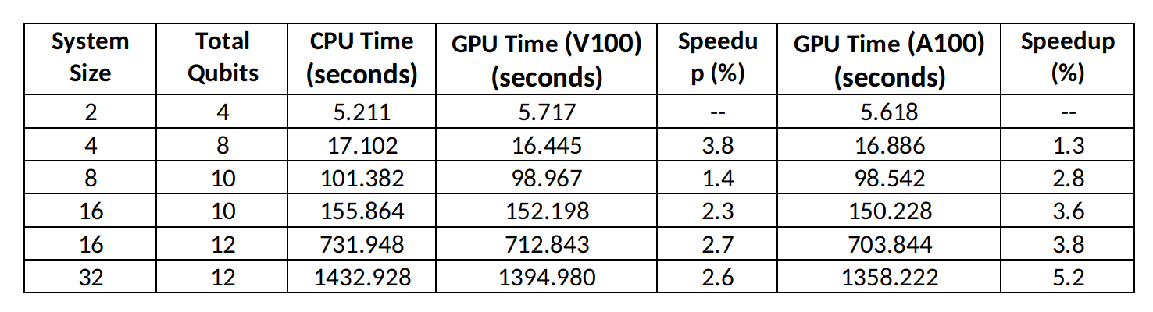

Title : TBD
Dhruv Sood¹, Manish Modani², Nilmani Mathur¹, Vikram Tripathi¹, Andreas Hehn²
¹Department of Theoretical Physics, Tata Institute of Fundamental Research, Mumbai
²Ask
The HHL Algorithm
Randomised Eigenvalues
Results
Add your information, graphs and images to this section.
After establishing the viability of the implementation and demonstrating the small but visible speedup achieved using cuQuantum, we moved onto testing it on matrices where the eigenvalues are not handpicked, but generated randomly.
This is expected to interfere with the phase estimation routine in the HHL algorithm, increasing the circuit depth and hence the time taken by the simulation. A table detailing the times taken in such runs is given below.
The HHL algorithm is a novel quantum algorithm for solving a linear system of equations with an exponential speedup as compared to classical methods. [ref to HHL paper]
It is thus a versatile with possible applications in several disciplines.
Quantum simulation can be used to test and refine the algorithm and it's implementations.
With the help of NVIDIA's cuQuantum SDK, we are able to speed up such simulations even further and thus better explore it's capabilities for when suitable quantum hardware is available. [ref to cuquantum]
Thus cuQuantum is able to speed up the simulation by upto 5.2%. We can further see that this speedup increases as we increase the size of the problem, which we attribute to the fact that at lower qubits the problem does not utilise all available cores. Indeed it seems that for the smallest system, the CPU run is faster than GPU-enabled runs.
On an average we find a speedup of 2.56% using V100 GPUs and 3.36% using A100 GPUs. Another characteristic evident from the date is that while the speedup attained via V100 GPUs appears to stagnate, the A100 speedup appears to still be rising. We will explore this in future work and look at how the speedup scales with system size and number of qubits.
The NVIDIA CuQuantum SDK
Simulation of quantum circuits on classical computers is key for researchers and developers to exploit the capabilities of Quantum Processing Units. To exploit the capabilities of CPU and GPU on classical system, NVIDIA CUDA Quantum is a first-of-its-kind, open-source platform for integrating and programming quantum processing units (QPUs), GPUs, and CPUs in one system. Similarly, NVIDIA cuQuantum SDK speed up quantum simulations by order of magnitude on NVIDIA GPUs. .
cuQuantum (https://developer.nvidia.com/cuquantum-sdk) consists of two major components, cuStatevec and cuTensorNet, the high-performance library for state vector and TensorNet simulations respectively. Modani et al (2022; 2023) demonstrated the performance advantage using cuStatevec for Shor’s algorithm, Quantum Fourier Transformation, and the Sycamore circuit. The speed up, between CPU only and A100 GPU enabled run, was demonstrated as ~143x, ~115x, and 104x for 30, 32, and 32 qubits respectively.
In the present, work, the cuStatevec enabled HHL algorithm employed to solve a linear system equations of various sizes and complexities. At this stage we have demonstrated the viability of this implementation. We plan to optimise the algorithm and it's implementation to maximise the speedup obtained and then we will apply it to solve physical problems.
A Test : Diagonal Matrices
We have tested the HHL algorithm for various matrix sizes and complexities. All runs were conducted first using only CPU capabilities, and then using V100 and A100 NVIDIA GPUs - where we expect the cuQuantum SDK to speed up the simulation of the quantum circuit.
The best results were obtained for systems where the matrix A is diagonal with entries corresponding to binary fractions upto a multiplicative constant. Such matrices were thus used to explore how large the system size can be without worrying much about the accuracy of the final result. A table of times taken for such runs is presented below.
Manish missed some files that he is running now. I will make this table once that is done.
Conclusions
%age speed ups for the gpu runs
References
references

